Slide 1

Module 1
Regularization
Notes:
Guidelines
Use section headers to chunk content in your presentation.
Use the same style of section header throughout your presentation.
Keep your title to no more than 2 lines.

Slide 2
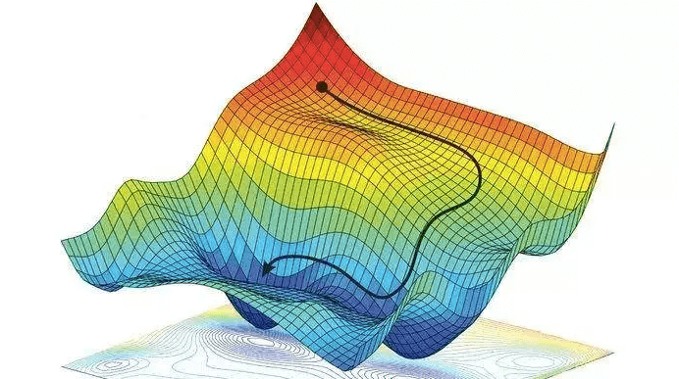
The Gradient Descent Algorithm
Notes:
Guidelines
Use a title slide at the beginning of your presentation. There are 9 variations of title slides to choose from.
If you will have a series of slideshows, we recommend using the same style of title slide for each presentation.
Keep your title to no more than 2 lines.
Do not change the font style or font size of the title or subtitle.

Slide 3
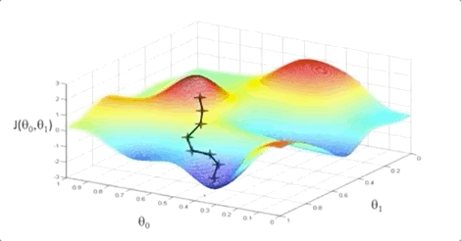
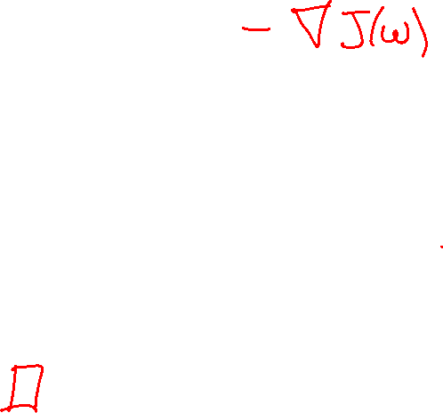
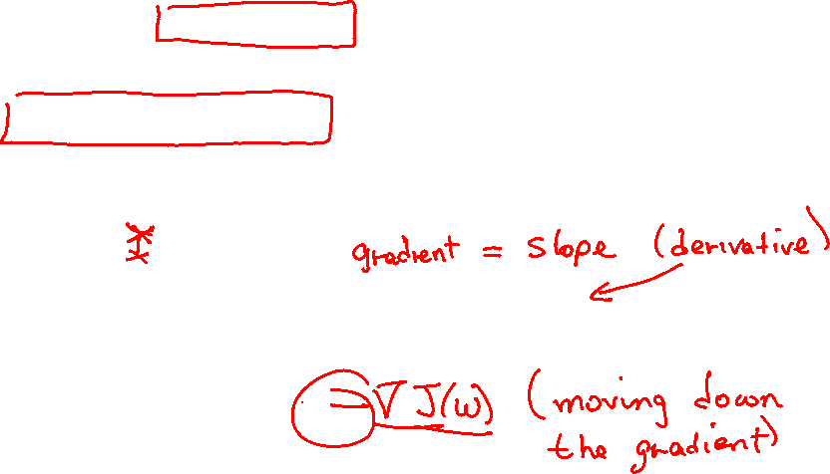
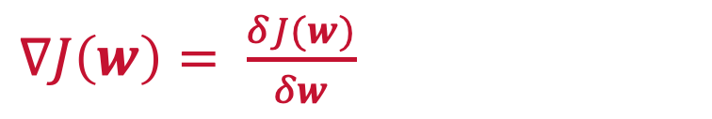
Gradient Descent
Gradient descent is an optimization algorithm used to find the minimum of a cost function.
It is based on moving downwards the gradient of the cost function in steps.
$∇J\left(w\right)= \frac{δJ(w)}{δw}$

Slide 4
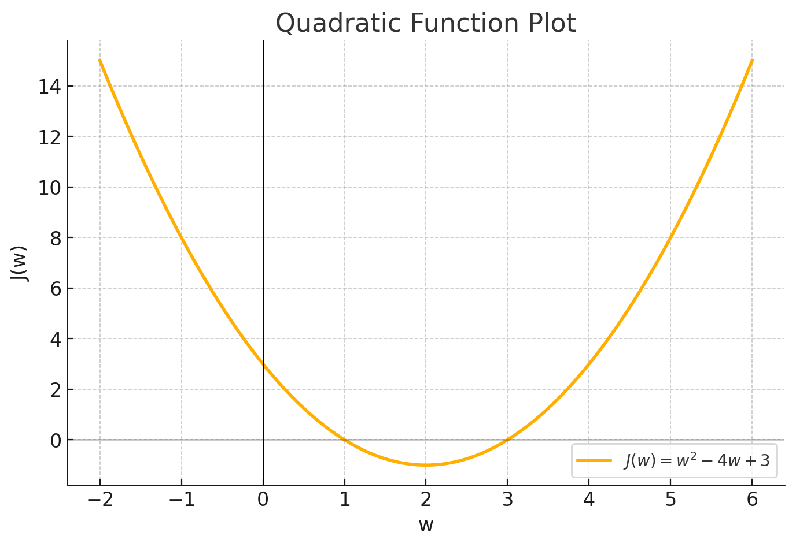
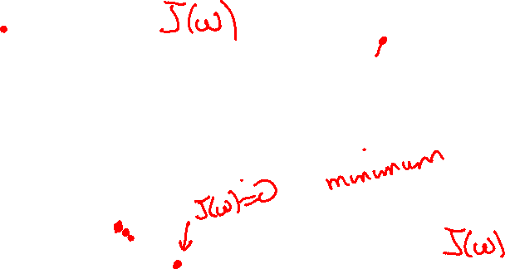

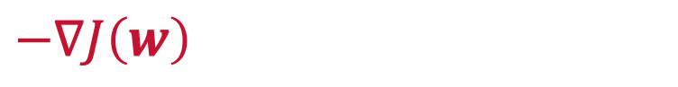
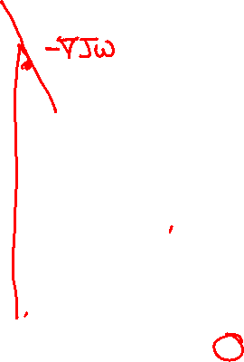
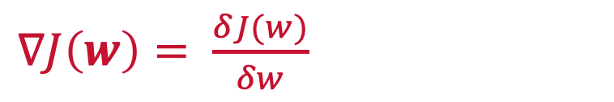
Gradient Descent
Moving down the gradient.
The negative gradient allows us to know how to update $w$
$∇J\left(w\right)= \frac{δJ(w)}{δw}$
$$−∇J\left(w\right)$$

Slide 5
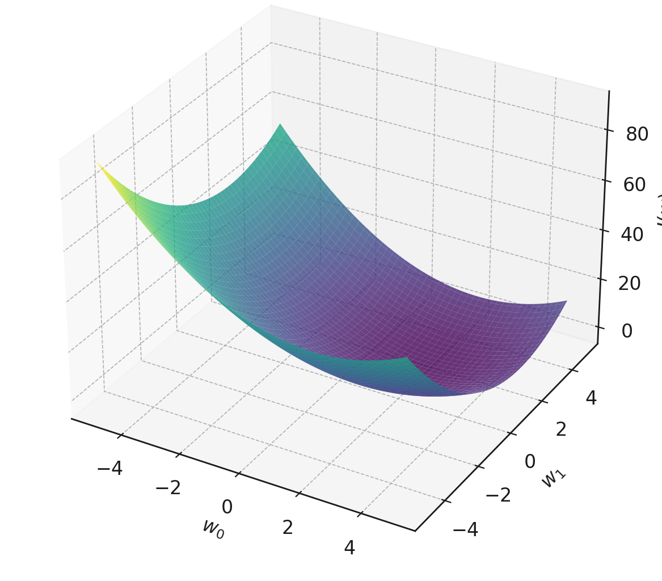
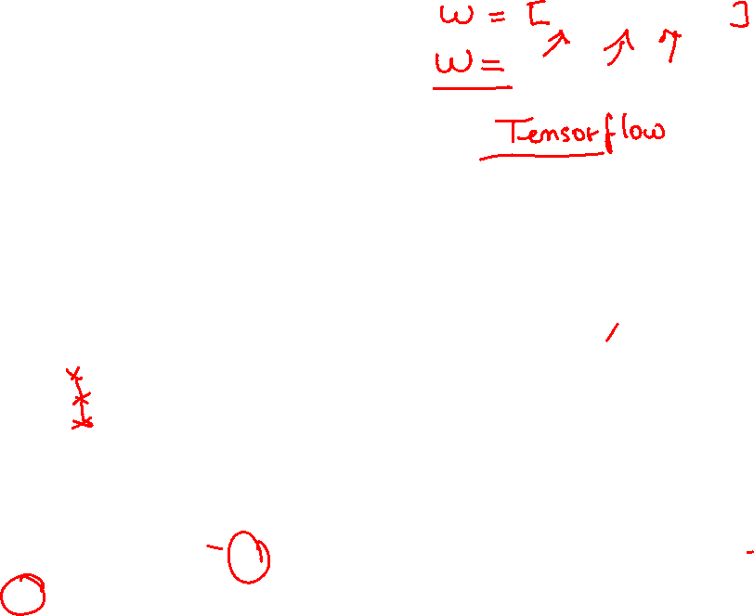
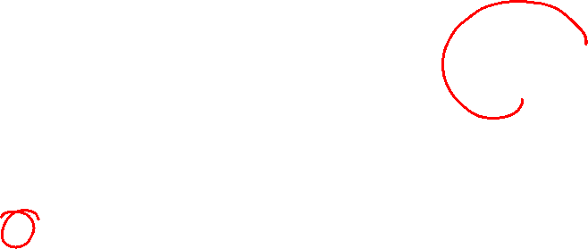
Gradient Descent
Moving down the gradient.
The negative gradient allows us to know how to update $w$
$∇J\left(w\right)= \frac{δJ(w)}{δw}$
$$−∇J\left(w\right)$$

Slide 6
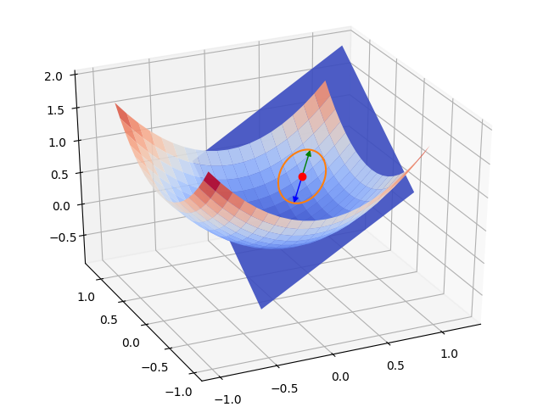
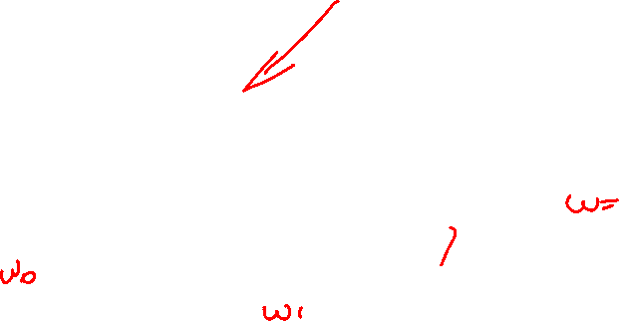
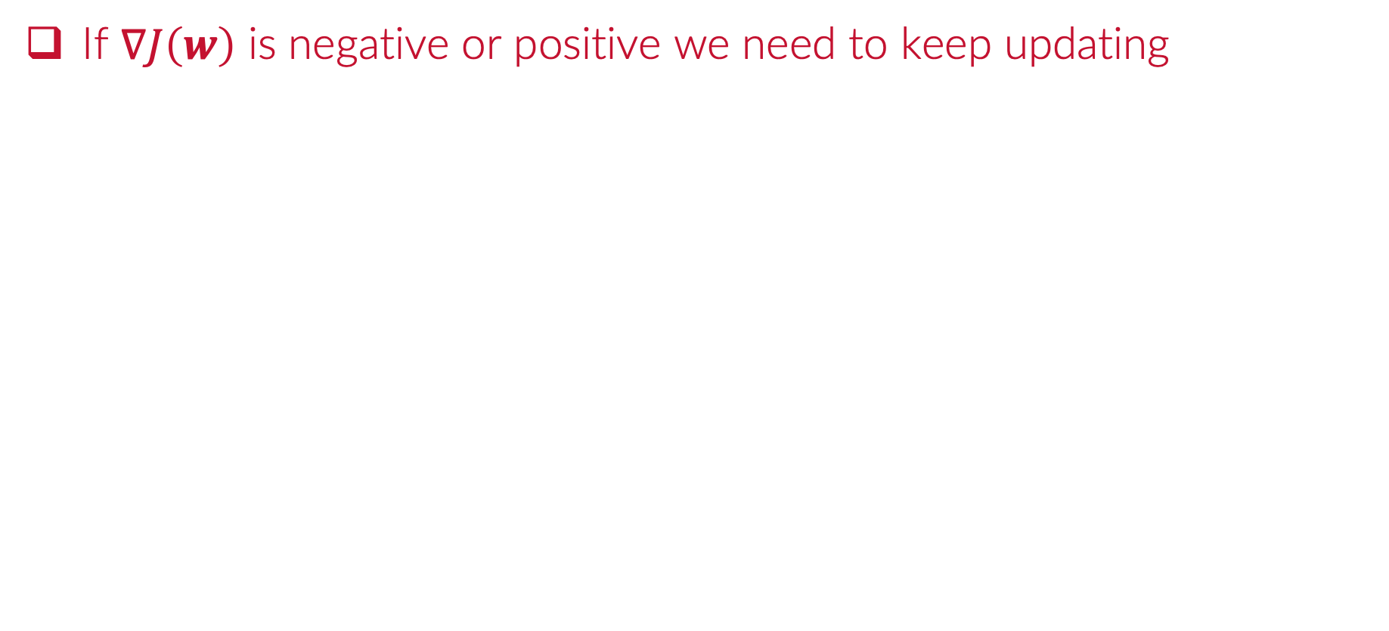
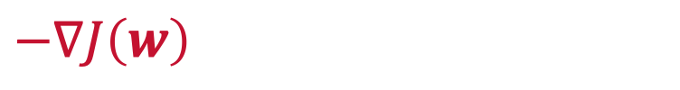
Gradient Descent
If $∇J\left(w\right)$ is negative or positive we need to keep updating
$$−∇J\left(w\right)$$
If $∇J\left(w\right)$ is negative or positive we need to keep updating

Slide 7
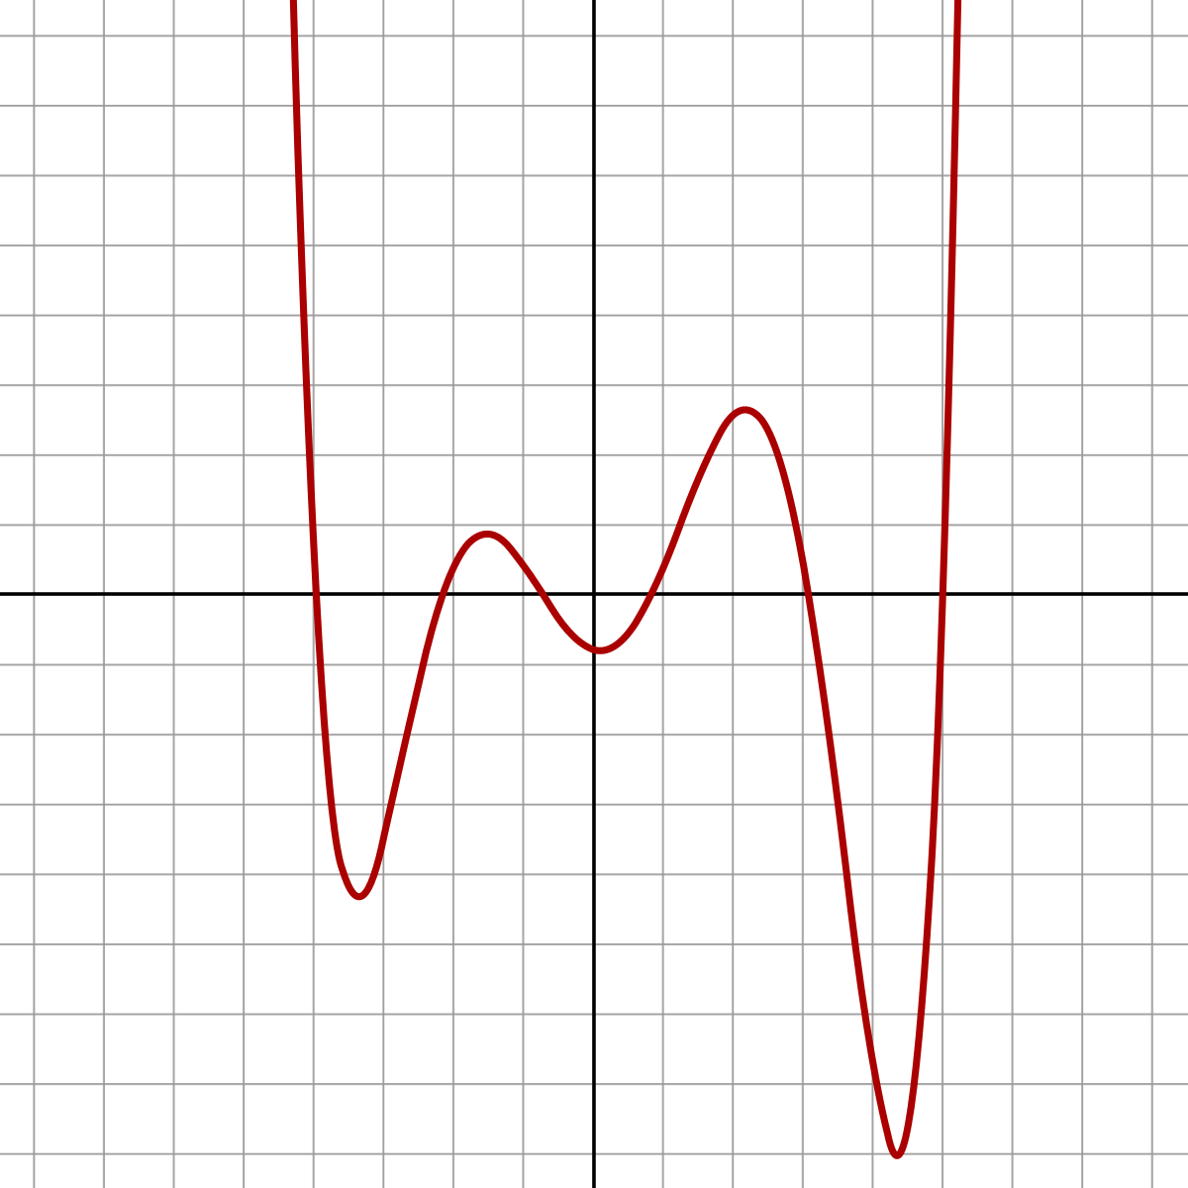

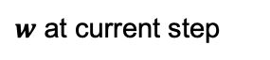
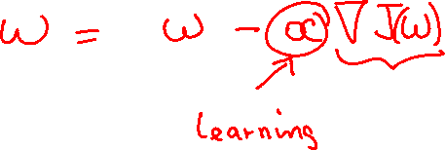
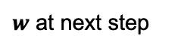

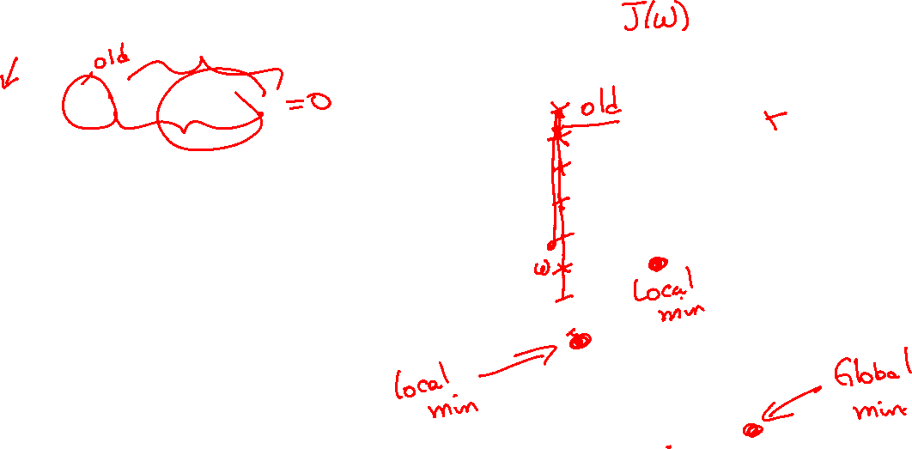
Gradient Descent Algorithm
The algorithm to update $w$
$$w_{i+1}=w_{i}−α∇J\left(w_{i}\right)$$
$w$ at next step
$w$ at current step
step size
gradient

Slide 8
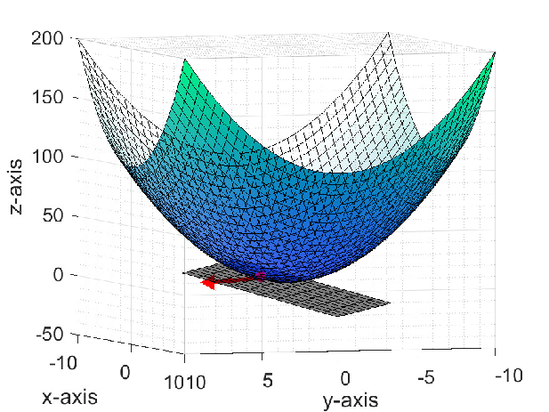
Gradient Descent Algorithm
The algorithm to update $w$
$$w_{i+1}=w_{i}−α∇J\left(w_{i}\right)$$
$w$ at next step
$w$ at current step
step size
gradient

Slide 9
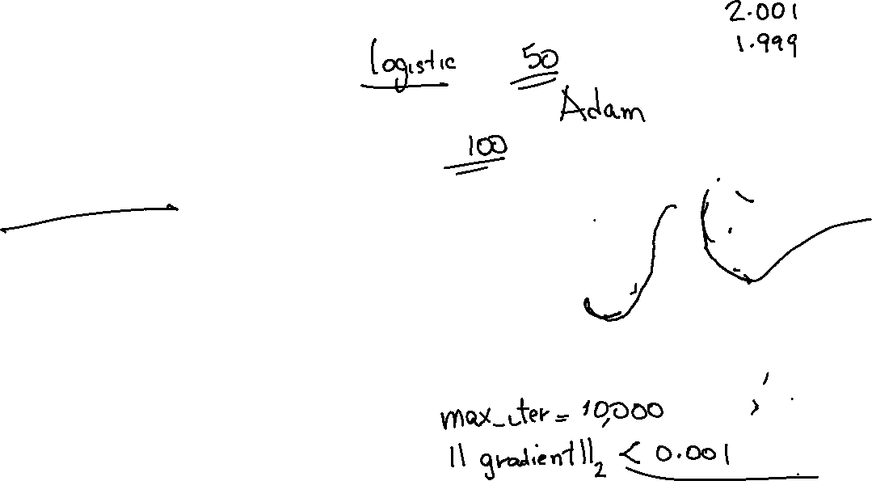
Gradient Descent Algorithm
The algorithm to update $w$
$$w_{i+1}=w_{i}−α∇J\left(w_{i}\right)$$
$w$ at next step
$w$ at current step
step size
gradient

Slide 10

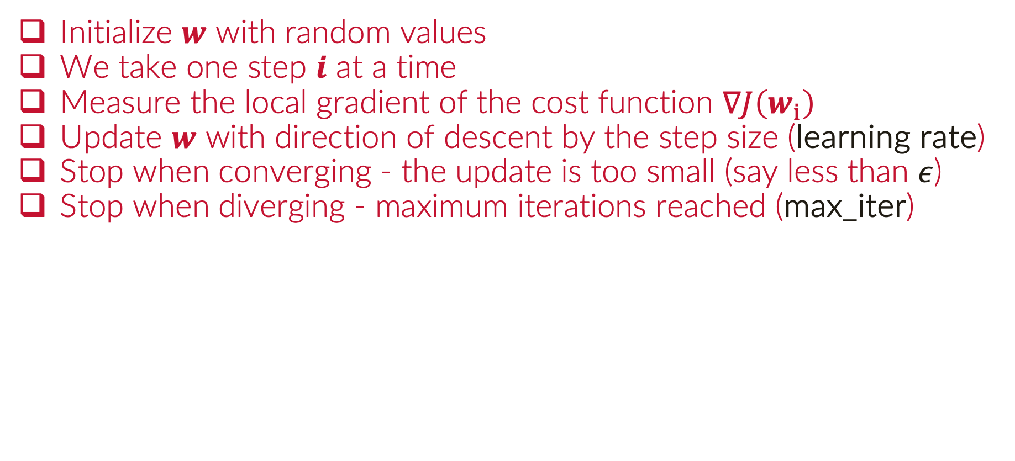
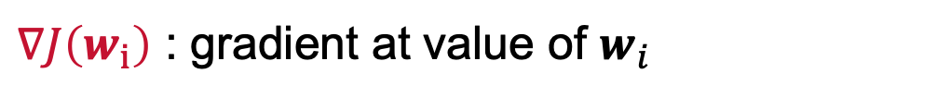
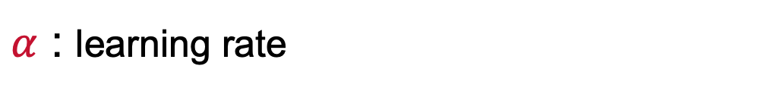
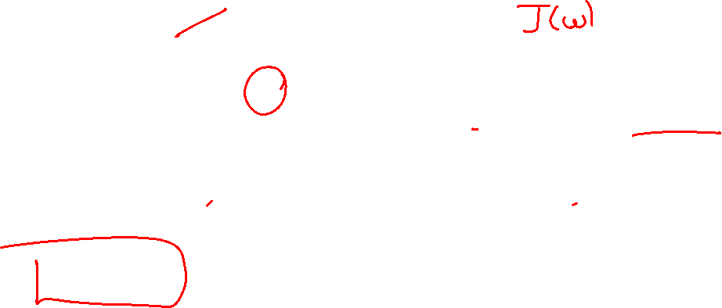

Algorithm Main Steps
Initialize $w$ with random values
We take one step $i$ at a time
Measure the local gradient of the cost function $∇J\left(w_{i}\right)$
Update $w$ with direction of descent by the step size (learning rate)
Stop when converging - the update is too small (say less than $ε$)
Stop when diverging - maximum iterations reached (max_iter)
$α$ : learning rate
$∇J\left(w_{i}\right)$ : gradient at value of $w_{i}$
$w_{i+1}=w_{i}−α∇J\left(w_{i}\right)$ : update

Slide 11
Elements of the GDA
Notes:
Guidelines
Use a title slide at the beginning of your presentation. There are 9 variations of title slides to choose from.
If you will have a series of slideshows, we recommend using the same style of title slide for each presentation.
Keep your title to no more than 2 lines.
Do not change the font style or font size of the title or subtitle.

Slide 12
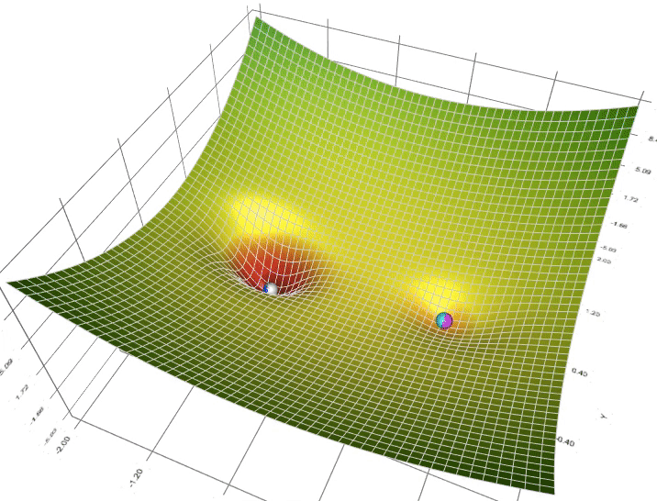
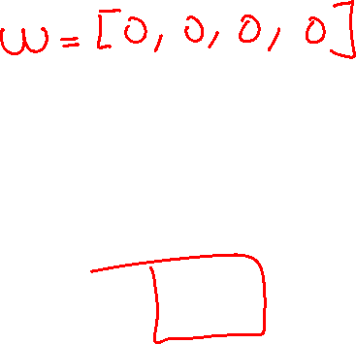

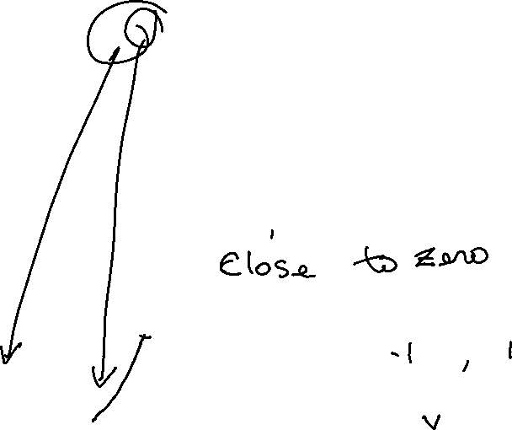
Initializing $w$
The parameters are initialized randomly
Random normal initializations for weights are common
The initialization affects the convergence to a minimum

Slide 13
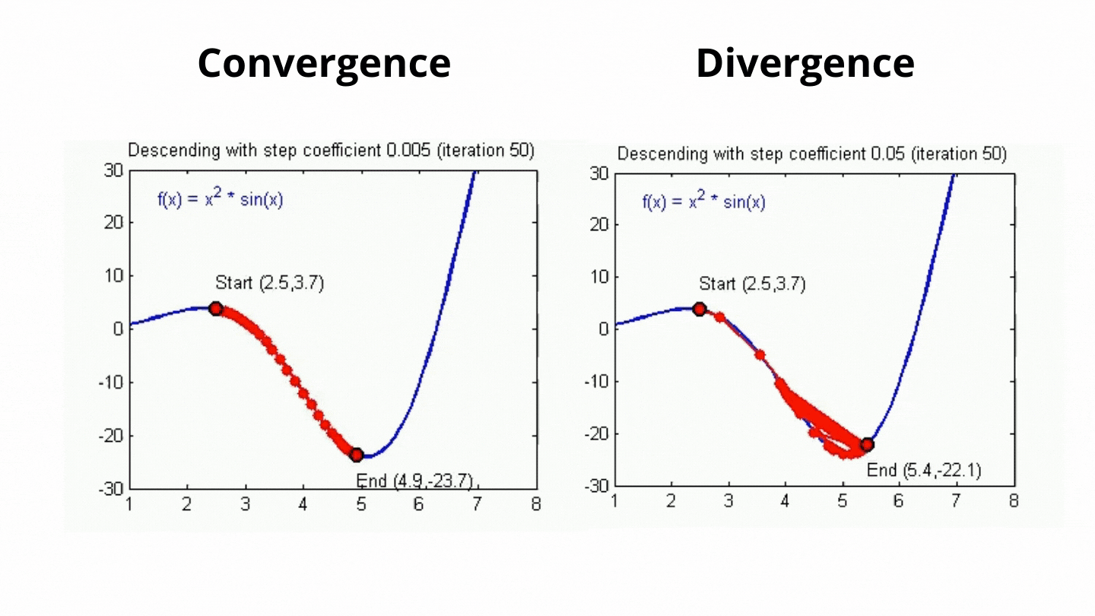

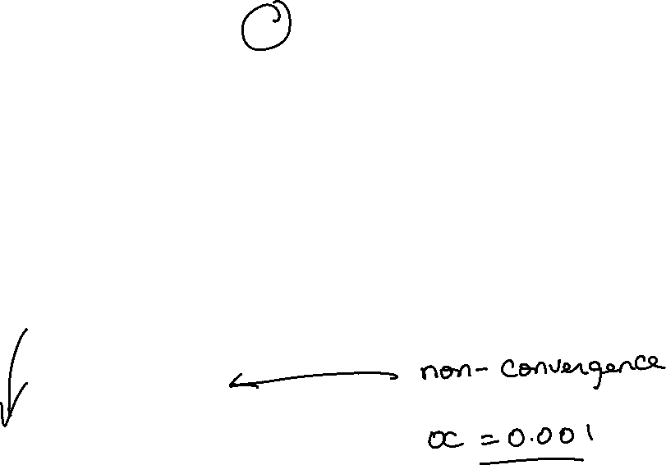

Learning Rate - $α$
This is the size of the step taken
A too small learning rate can cause the algorithm to take too many steps to converge to the minimum
A too large learning rate can overshoot (diverge from) the minimum

Slide 14
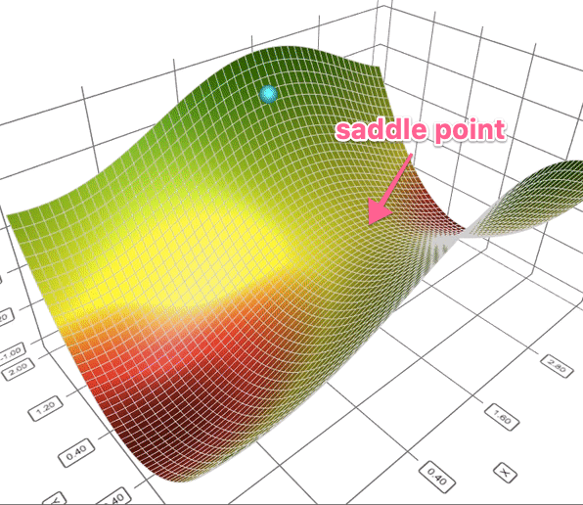
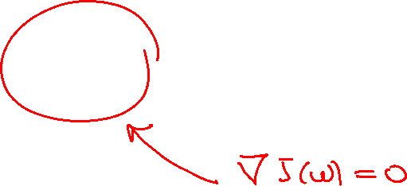

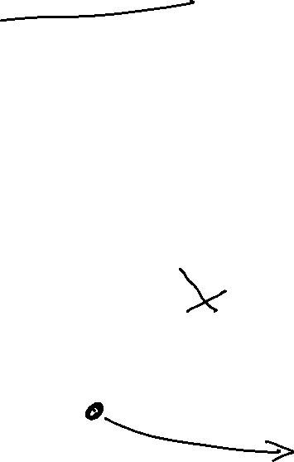
Gradients $∇J\left(w\right)$ Can be Zero at:
A global minimum
A local minimum
A saddle point (neither a local or global minimum)

Slide 15
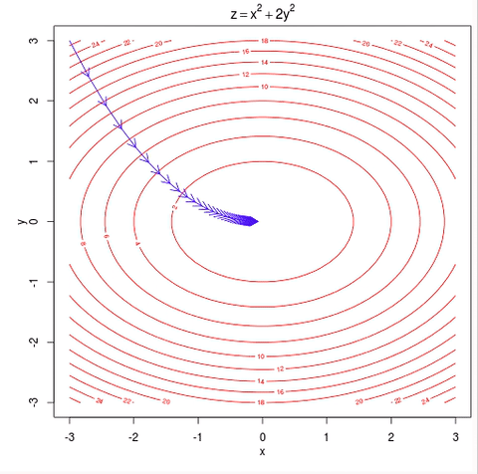
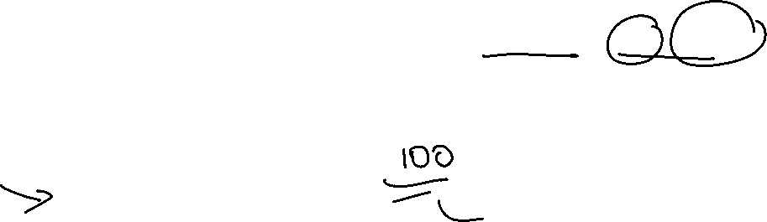
Number of Iterations:
Gradient descent might continue to run infinitely if not stopped
The maximum number of steps (iterations) are set in advance
Most algorithms have parameters such as max_iter, iter, n_iter

Slide 16
Python
Notes:
Guidelines
Use a title slide at the beginning of your presentation. There are 9 variations of title slides to choose from.
If you will have a series of slideshows, we recommend using the same style of title slide for each presentation.
Keep your title to no more than 2 lines.
Do not change the font style or font size of the title or subtitle.

Slide 17
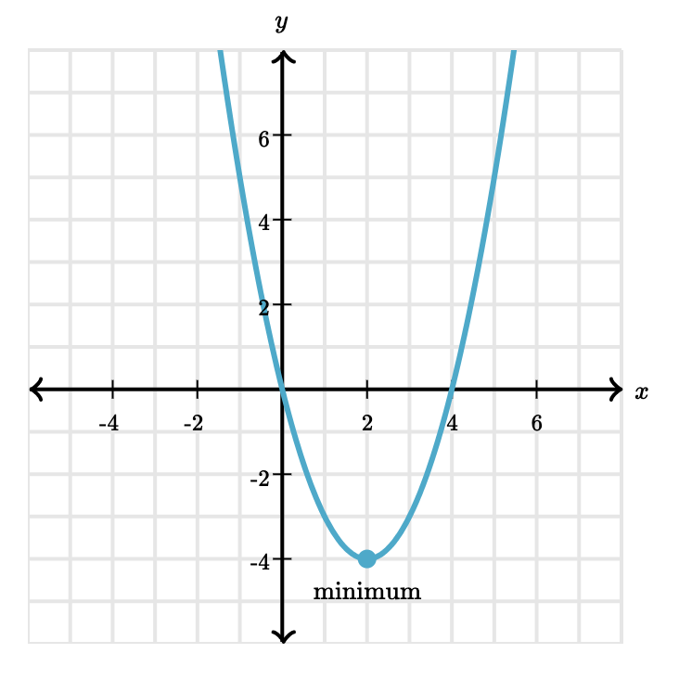
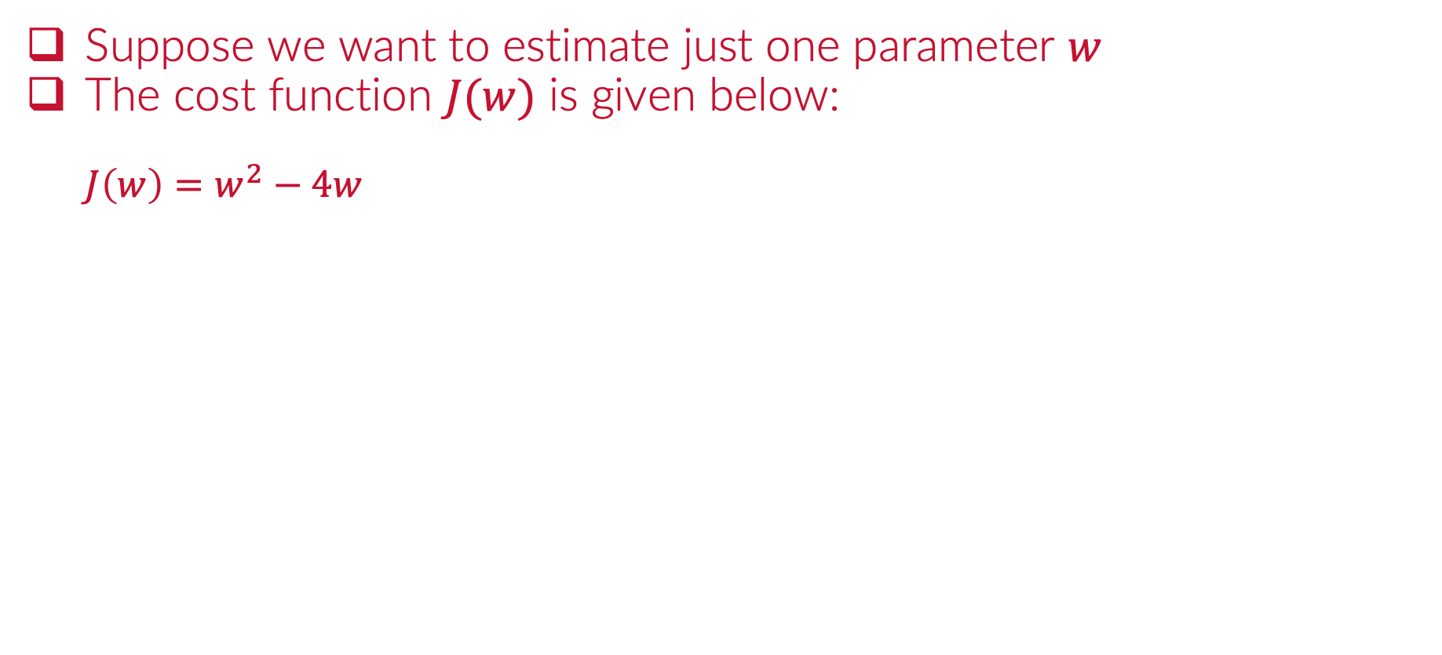
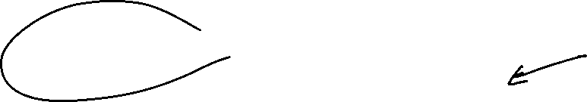
Example: Convex
Suppose we want to estimate just one parameter $w$
The cost function $J(w)$ is given below:
$$J\left(w\right)=w^{2}−4w$$

Slide 18
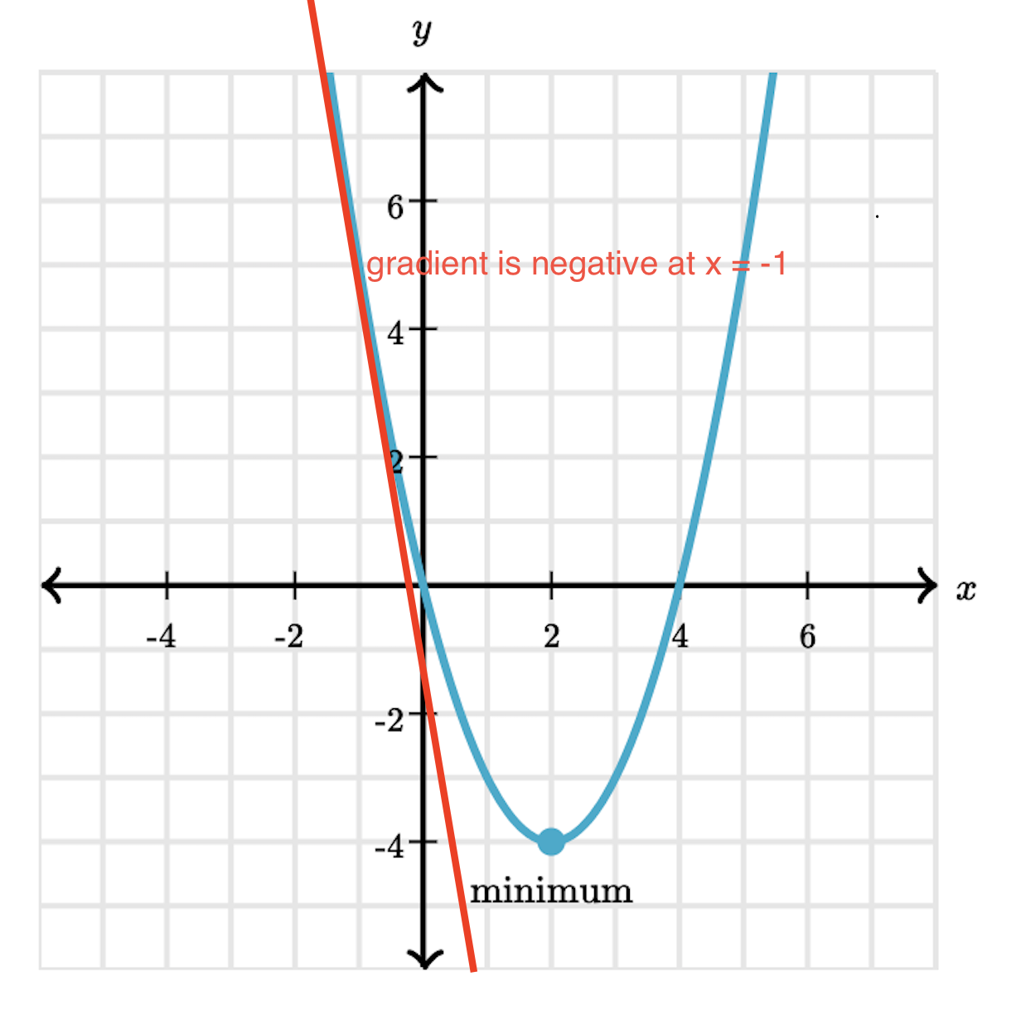
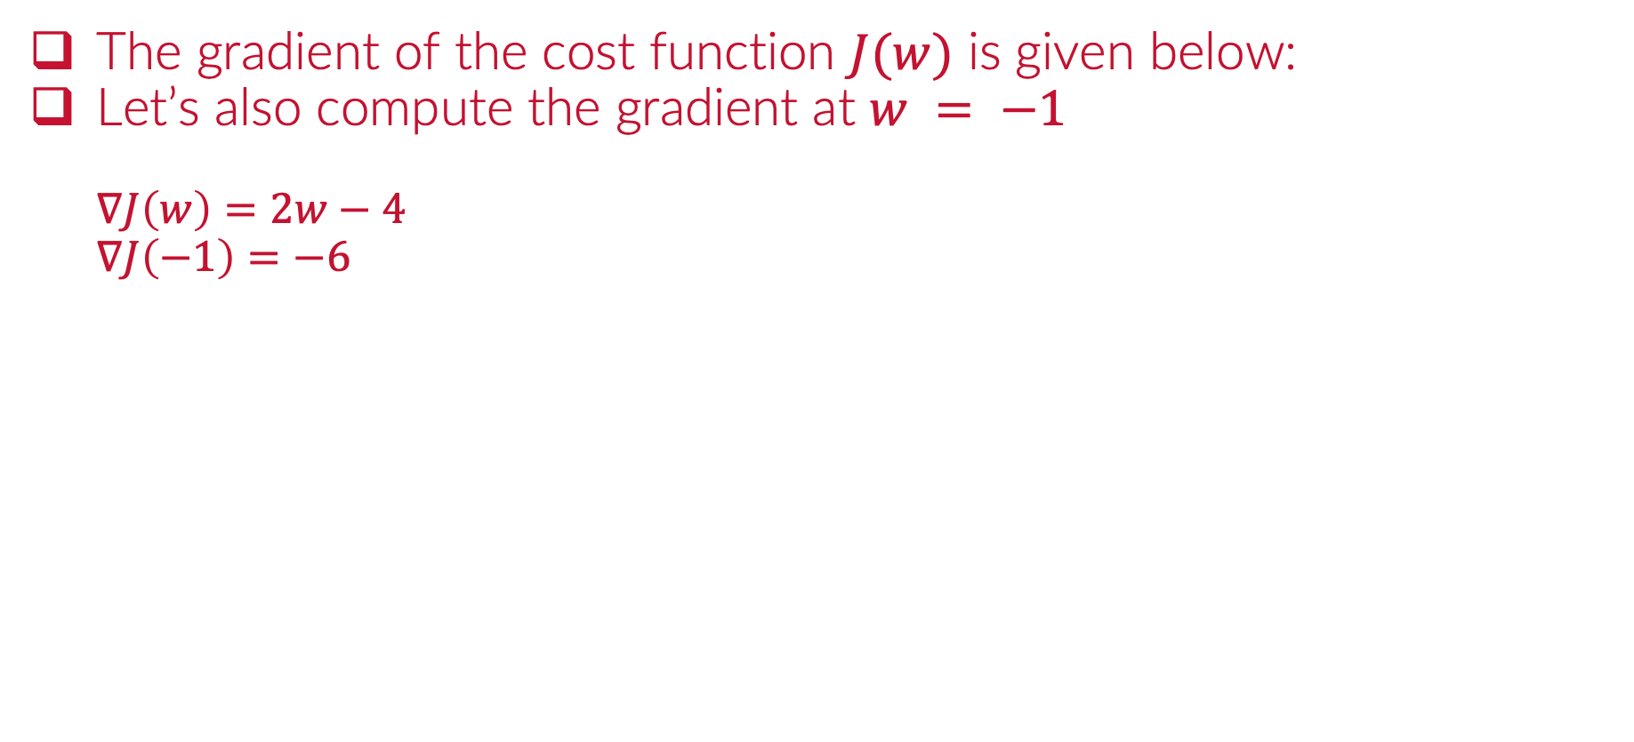
Example: Convex
The gradient of the cost function $J(w)$ is given below:
Let’s also compute the gradient at $w = −1$
$$∇J\left(w\right)=2w−4$$
$$∇J\left(−1\right)=−6$$

Slide 19
Python
Notes:
Guidelines
Use a title slide at the beginning of your presentation. There are 9 variations of title slides to choose from.
If you will have a series of slideshows, we recommend using the same style of title slide for each presentation.
Keep your title to no more than 2 lines.
Do not change the font style or font size of the title or subtitle.

Slide 20
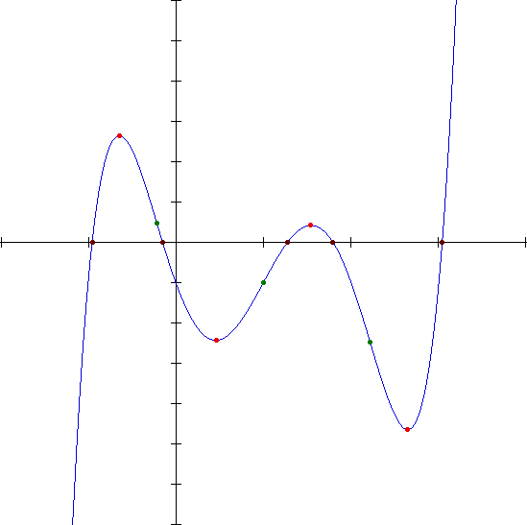
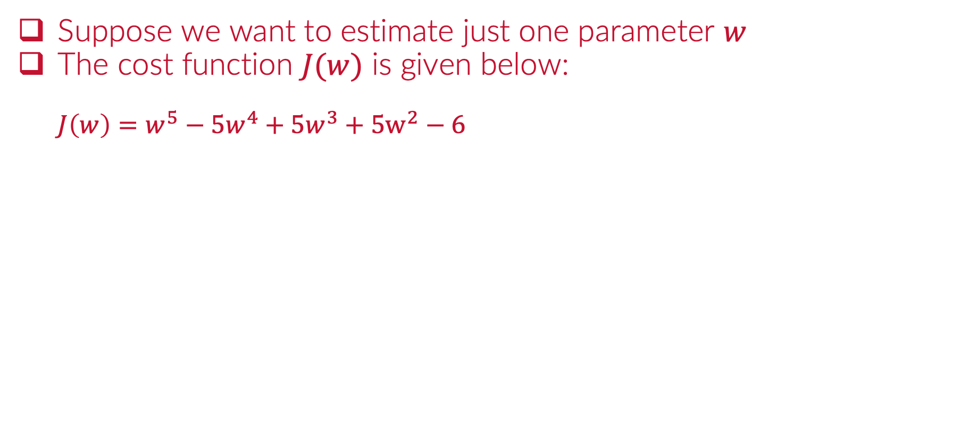

Example: Non-Convex
Suppose we want to estimate just one parameter $w$
The cost function $J(w)$ is given below:
$$J\left(w\right)=w^{5}−5w^{4}+5w^{3}+5w^{2}−6$$

Slide 21
Python
Notes:
Guidelines
Use a title slide at the beginning of your presentation. There are 9 variations of title slides to choose from.
If you will have a series of slideshows, we recommend using the same style of title slide for each presentation.
Keep your title to no more than 2 lines.
Do not change the font style or font size of the title or subtitle.

Slide 22
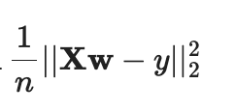
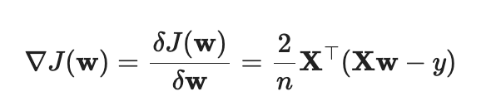

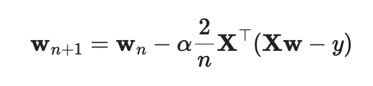
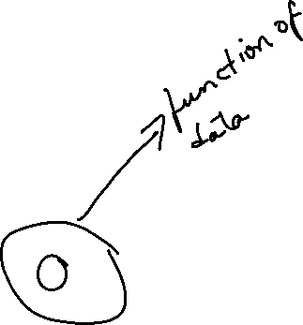
Gradient Descent for Regression
Using MSE cost function:
Gradient
GDA

Slide 23
Python
Notes:
Guidelines
Use a title slide at the beginning of your presentation. There are 9 variations of title slides to choose from.
If you will have a series of slideshows, we recommend using the same style of title slide for each presentation.
Keep your title to no more than 2 lines.
Do not change the font style or font size of the title or subtitle.

Slide 24
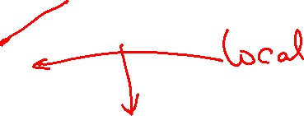

Optimizers:
Get unstuck of local minima
Speed up convergence

Slide 25





Batch Gradient Descent
We can use parts of the data set to update $w$
$$y$$
$$X$$

Slide 26



Batch Gradient Descent
We can use parts of the data set to update $w$
${\left\{X_{i},y_{i}\right\}}_{i=1}^{2}$- Batch = 2
$$y$$
$$X$$

Slide 27
Batch Gradient Descent
We can use parts of the data set to update $w$
$$y$$
$$X$$

Slide 28
Batch Gradient Descent
We can use parts of the data set to update $w$
$$y$$
$$X$$

Slide 29

Batch Gradient Descent
We can use parts of the data set to update $w$
Completed 1 epoch
$$y$$
$$X$$

Slide 30

Stochastic Gradient Descent (SGD)
We can use parts of the data set to update $w$
Mini batch of 1 observation
$$y$$
$$X$$

Slide 31



Momentum
Improves on gradient descent by using the acceleration of cost.
Goal: get unstuck

Slide 32



Adam Optimizer
Uses both velocity and acceleration

Slide 33
Python
Notes:
Guidelines
Use a title slide at the beginning of your presentation. There are 9 variations of title slides to choose from.
If you will have a series of slideshows, we recommend using the same style of title slide for each presentation.
Keep your title to no more than 2 lines.
Do not change the font style or font size of the title or subtitle.

Slide 34




Gradient Descent in LR
$$J(w)$$
$$w_{0}$$
$$w_{1}$$
Notes:
Guidelines
Use a title slide at the beginning of your presentation. There are 9 variations of title slides to choose from.
If you will have a series of slideshows, we recommend using the same style of title slide for each presentation.
Keep your title to no more than 2 lines.
Do not change the font style or font size of the title or subtitle.

Slide 35



Example: Convex Cost Function
Assume there is an unknown function $f:X \underset{→}{maps}y$
Assume a linear estimator (hypothesis) $h:X \underset{→}{maps}y$ works well

Slide 36





Example: Convex Cost Function
Assume there is a unknown function $f:X \underset{→}{maps}y$
Assume a linear estimator (hypothesis) $h:X \underset{→}{maps}y$ works well
If $h$ is linear regression, then cost function SSE is convex
$$J(w_{0},w_{1})$$
Global minimum
$$w_{0}$$
$$w_{1}$$

Slide 37




Example: Convex Cost Function
We can find the parameter vector $w=[w_{0}, w_{1}]$ minimizing SSE
We do need to create a design matrix $X=[1 x_{1}]$
The model predictions would be: $h_{w}(X)=$ $X$ $w$
$X$ $w$
$X$ $w$

Slide 38



Example: Convex Cost Function
We can find the parameter vector $w=[w_{0}, w_{1}]$ minimizing SSE
We do need to create a design matrix $X=[1 x_{1}]$
The model predictions would be: $h_{w}(X)=$ $X$ $w$
Bias or Intercept
features
$$+ε$$
1) Create y vector
2) Create X Matrix (also Called the Design/Model Matrix)

Slide 39



Example: Convex Cost Function
We can find the parameter vector $w=[w_{0}, w_{1}]$ minimizing SSE
We do need to create a design matrix $X=[1 x_{1}]$
The model predictions would be: $h_{w}(X)=$ $X$ $w$
$$w=\left[\begin{matrix}w_{0} \\ w_{1} \\ \begin{aligned}⋮ \\ w_{k}\end{aligned}\end{matrix}\right]$$

Slide 40



Example: Convex Cost Function
Cost function is SSE
$$J\left(w\right)={\left(y−Xw\right)}^{⊤}\left(y−Xw\right)={\left\|y−Xw\right\|}_{2}^{2}$$
$$J(w)$$
Global minimum
$$w_{0}$$
$$w_{1}$$

Slide 41



Example: Convex Cost Function
Gradient is the derivative of the cost function WRT parameters.

Slide 42



Example: Convex Cost Function
Setting the gradient to zero and solving for $w$ gets solution for min.
Set to zero and solve for $w$
$$w={\left(X^{⊤}X\right)}^{−1}(X^{⊤}y)$$
$$J(w)$$
Global minimum
$$w_{0}$$
$$w_{1}$$

Slide 43
Python
Notes:
Guidelines
Use a title slide at the beginning of your presentation. There are 9 variations of title slides to choose from.
If you will have a series of slideshows, we recommend using the same style of title slide for each presentation.
Keep your title to no more than 2 lines.
Do not change the font style or font size of the title or subtitle.

